Slide 1
PMG 4101: Project Management
Syed Samin Sadaf
Lecturer
Department of CSE,
United International University (UIU)

Slide 2
eXtreme Programming
Methodology

Slide 3
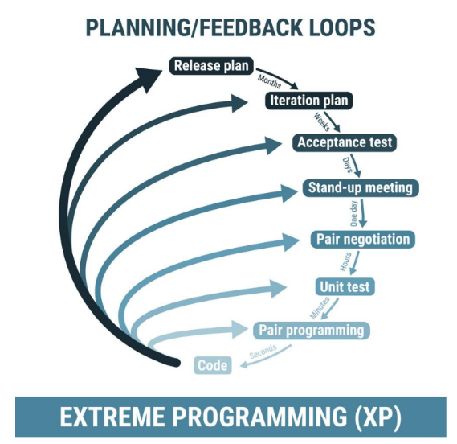
eXtreme Programming Methodology
Focuses on frequent releases of software versions within short time frames
Allows the developers to incorporate new requirements as needed with each version.
Relies on regular feedback and open communication with the client to establish these requirements.
XP helps ensure all the members of the development team are aware of the project goals and can align their efforts.

Slide 4
Advantages
Allows software development companies to save costs and time required for project realization.
Time savings are available because XP focuses on the timely delivery of final products.
Extreme Programming teams save lots of money because they don’t use too much documentation. They usually solve problems through discussions inside of the team.

Slide 5
Advantages
Simplicity is one more advantage of Extreme Programming projects. The developers who prefer to use this methodology create extremely simple code that can be improved at any moment.
The whole process in XP is visible and accountable.
Constant feedback is also the strong side.
XP assists to create software faster thanks to the regular testing at the development stage.

Slide 6
Disadvantages
Some specialists say that Extreme Programming is focused on the code rather than on design.
That may be a problem because good design is extremely important for software applications. It helps sell them in the software market.
Additionally, in XP projects the defect documentation is not always good. Lack of defect documentation may lead to the occurrence of similar bugs in the future.

Slide 7
Disadvantages
Does not measure code quality assurance and may cause defects in the initial code.
XP is not the best option if programmers are separated geographically.

Slide 8
When to use XP
✓ Expect their system’s functionality to change every few months.
✓ Experience constantly changing requirements or work with customers who aren’t sure what they want the system to do.
✓ Want to mitigate project risk, especially around tight deadlines.
✓ Are able to work closely with customers.

Slide 9
Boehm’s Spiral Methodology

Slide 10
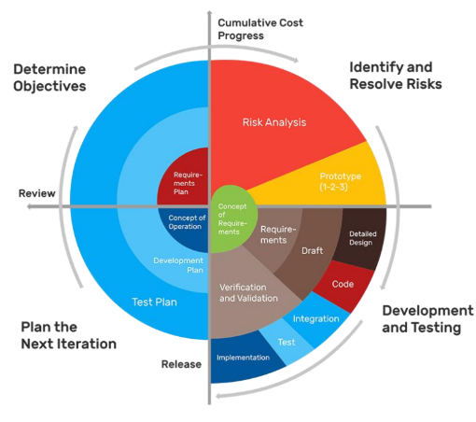
Boehm’s Spiral Methodology
The spiral model, initially proposed by Boehm,
is an evolutionary software process model that
couples the iterative feature of prototyping with → controlled and systematic aspects of the linear sequential model.
It implements the potential for rapid development of new versions of the software.

Slide 11
Boehm’s Spiral Methodology
Using the spiral model, the software is developed in a series of incremental releases.
During the early iterations, the additional release may be a paper model or prototype.
During later iterations, more and more complete versions of the engineered system are produced.

Slide 12
Advantages
High amount of risk analysis
Useful for large and mission-critical projects.

Slide 13
Disadvantages
Can be a costly model to use.
Risk analysis needed highly particular expertise
Doesn't work well for smaller projects.

Slide 14
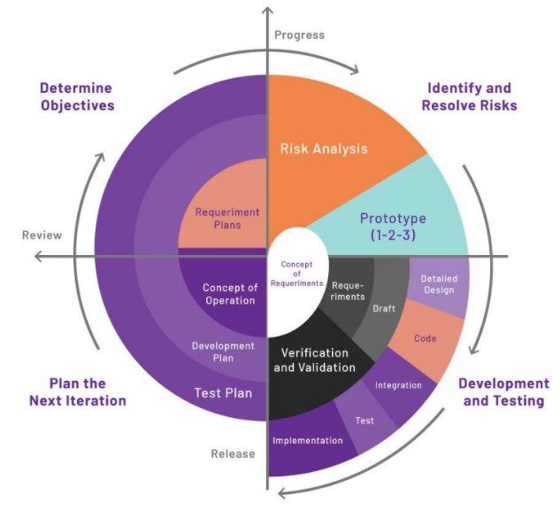
When to Choose Boehm’s Spiral Methodology?
When deliverance is required to be frequent.
When the project is large
When requirements are unclear and complex
When changes may require at any time
Large and high budget projects

Slide 15
Incremental Software Development Methodology

Slide 16
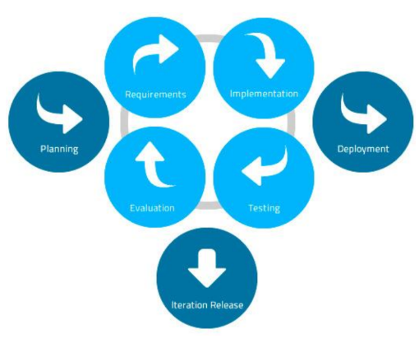
What is Incremental Software Development Methodology
Incremental Model is a process of software development where
requirements are broken down into
multiple standalone modules of software development cycle.
Incremental development is done in
steps from analysis design, implementation, testing/verification, maintenance.

Slide 17
What is Incremental Software Development Methodology
Each iteration passes through the requirements, design, coding and testing phases.
And each subsequent release of the system adds function to the previous
release until all designed functionality has been implemented.

Slide 18
What is Incremental Software Development Methodology
System development is broken down into many mini development projects.
Partial systems are successively built to produce a final total system
Highest priority requirement is tackled first
Once the requirement is developed, requirement for that increment are frozen

Slide 19
Advantages
The software will be generated quickly during the software life cycle
It is flexible and less expensive to change requirements and scope
Throughout the development stages changes can be done
This model is less costly compared to others
A customer can respond to each building
Errors are easy to be identified

Slide 20
Disadvantages
It requires a good planning designing
Problems might cause due to system architecture as such not all requirements collected up front for the entire software lifecycle
Each iteration phase is rigid and does not overlap each other
Rectifying a problem in one unit requires correction in all the units and consumes a lot of time

Slide 21
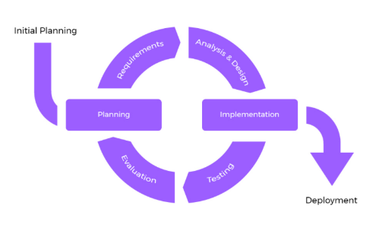
When to Choose Incremental Software Development?
✓ Requirements of the system are clearly understood
✓ When demand for an early release of a product arises
✓ When software engineering team are not very well skilled or trained
✓ When high-risk features and goals are involved
✓ Such methodology is more in use for web application and product based companies

Slide 22
Any Questions?

Slide 23
Acknowledgement
Slide Courtesy:
Dr. Suman Ahmed, Professor, CSE Department, UIU

Slide 24
Thank You!

